Slide 1
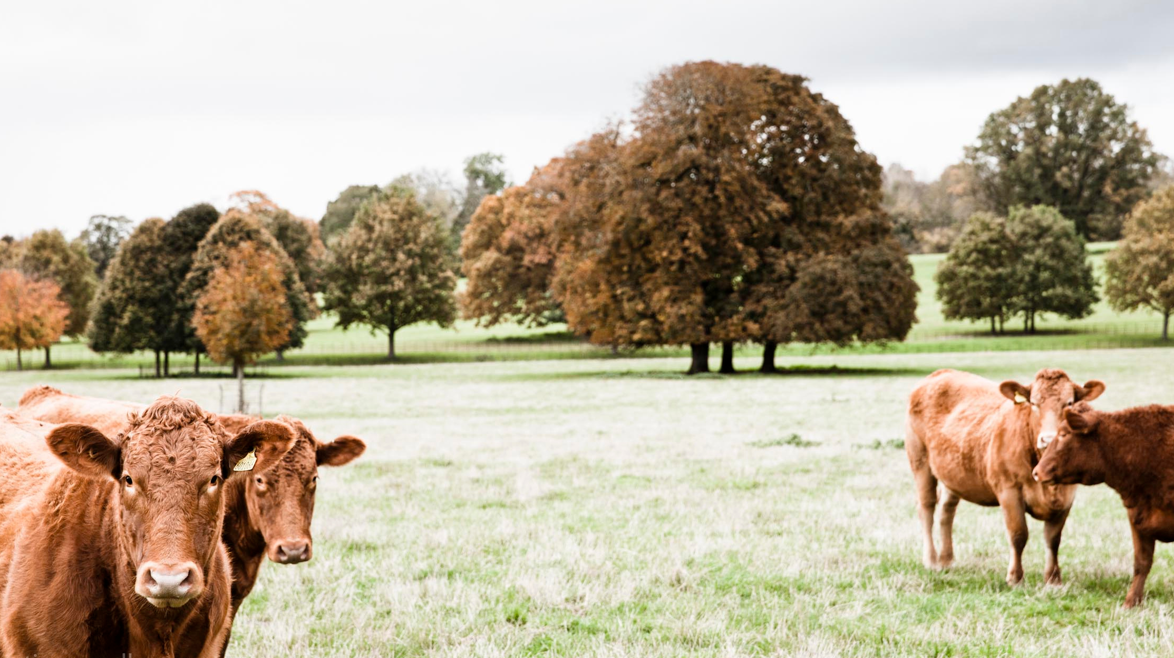
FUTURE FOODIE
INTERNSHIP PROGRAMME

Slide 2
SO, WHAT IS THE FUTURE FOODIE INTERNSHIP ALL ABOUT?
We are thrilled to offer our interns a rare and very exciting opportunity to learn about and work “hands-on” with all aspects of food. This unique training scheme is aimed at anyone who wants to grow their love for food and develop their skills and knowledge whilst they do so.
This 12-month intensive induction programme will offer you a wealth of opportunity to develop your foodie credentials, giving you unique exposure to some of the country’s leading artisan craftsmen who work at the very core of our business.
And all based at the heart of our business, in Daylesford in Gloucestershire

Slide 3
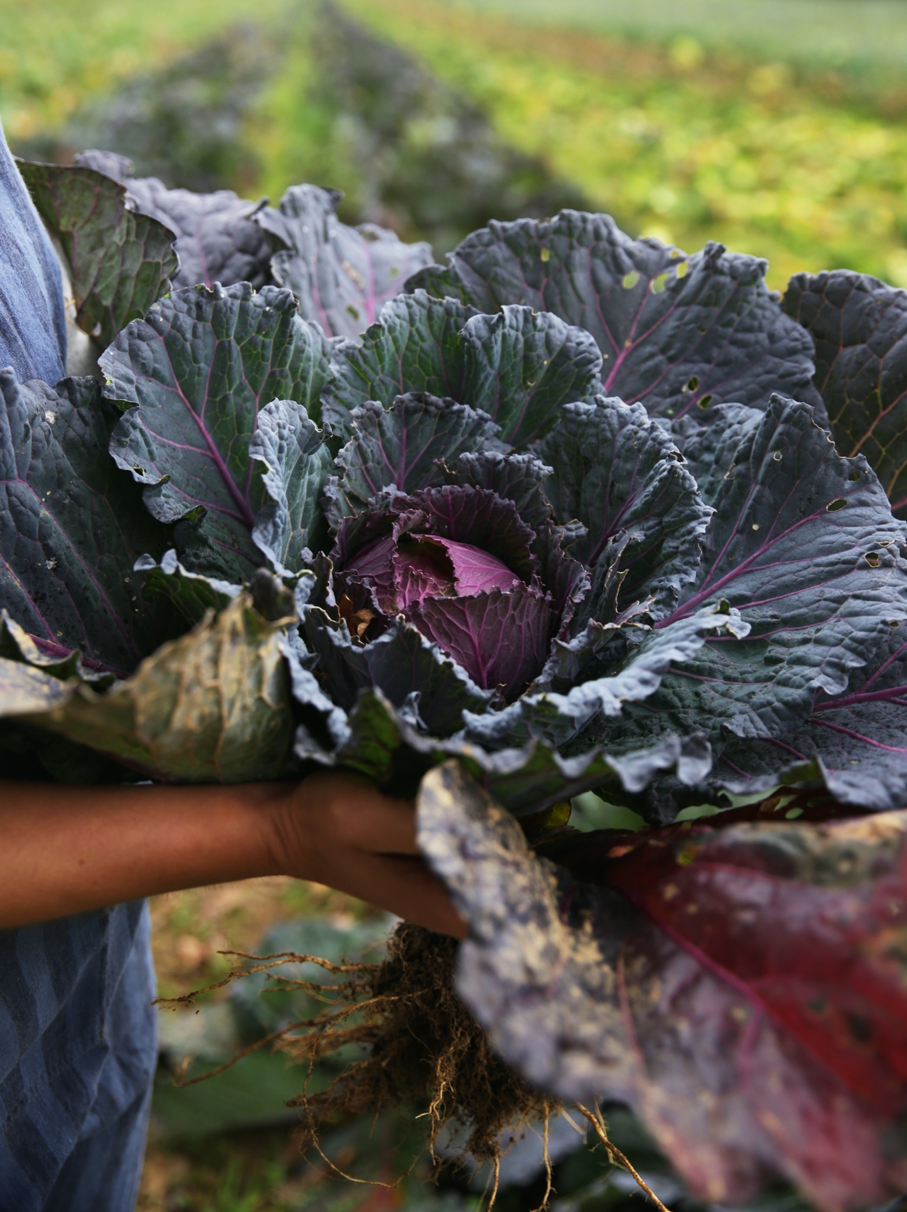
WHAT IS DAYLESFORD ORGANIC?
Daylesford is an Organic farm founded by Lady Carole Bamford in 2002.
Nature is at the heart of everything Daylesford creates.
Daylesford celebrates artisan craftsmanship by producing and manufacturing food at our Gloucestershire farm and then supplying this to our London shops and external distributors.
In our business, we house various production units: i.e., the creamery, patisserie and the black barn, all of which develop and create the delicious products that we have become renowned for
See more here: https://www.daylesford.com/discover/about-us

Slide 4
WHERE WILL YOU WORK?
THE MARKET GARDEN
THE BLACK BARN
THE CHARCUTERIE
THE PATISSERIE
THE BAKERY
THE CREAMERY
THE KITCHENS
THE COOKERY SCHOOL
THE DELI
4
3
3
6
6
6
9
6
3
WEEKS
WEEKS
WEEKS
WEEKS
WEEKS
WEEKS
WEEKS
WEEKS
WEEKS

Slide 5
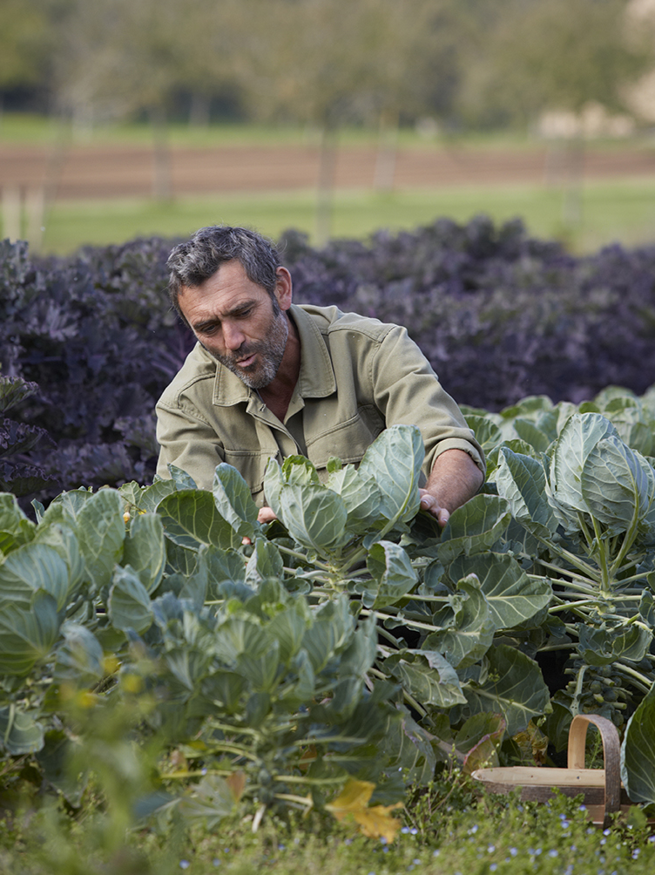
4
WEEKS
THE MARKET GARDEN
You will work alongside Horticulturalist Jez Taylor and his team in the market garden for 4 weeks.
Our garden is 100% Organic, and we produce hundred of varieties of fruit and vegetables each year.
You will experience 1 week per season, working outdoors in autumn, winter, spring and summer.
Whilst harvesting, weeding and seed sowing you will learn the finer details of Market Gardening from Jez, and experience the complexities of British seasonality.

Slide 6
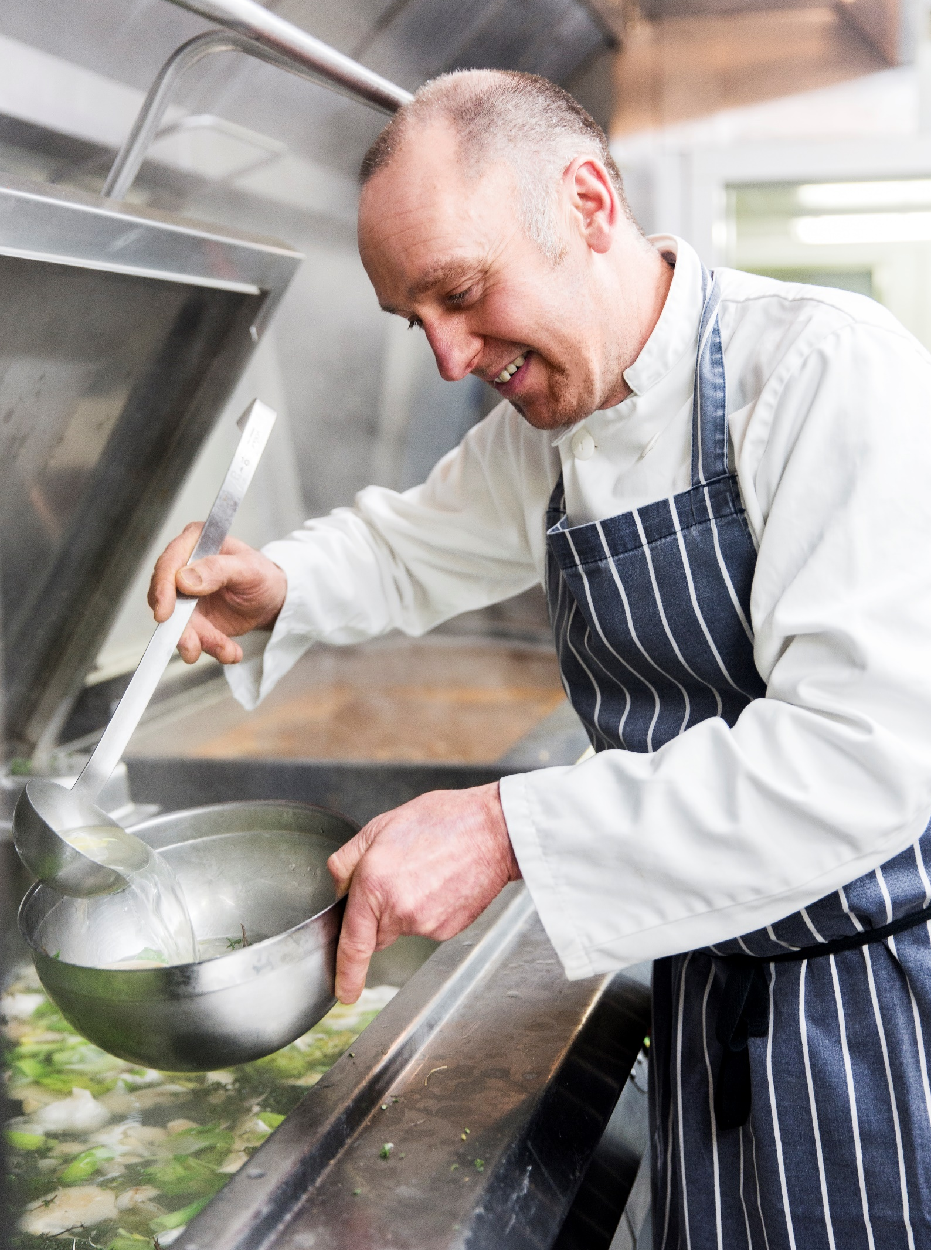
THE BLACK BARN
3
WEEKS
Working with experienced chef Andy Wheeler, you will spend 4 weeks in the Black Barn production unit
The Black Barn produces all our soups and ready meals that are sold in our farmshops and online.
During this time, you will experience the cooking, prepping and packing of the soups from start to finish, and will witness food production on a larger scale.

Slide 7
3
WEEKS
THE CHARCUTERIE
The Charcuterie is our ham hub, run by Chris Webb.
Here you will spend 3 weeks, learning how pork becomes ham. You will be involved with the brining, soaking, smoking and curing of the ham joint.
During this process, you will also slice and pack the ham ready for distribution.
The Charcuterie also prepares our selection of delicious pates.

Slide 8
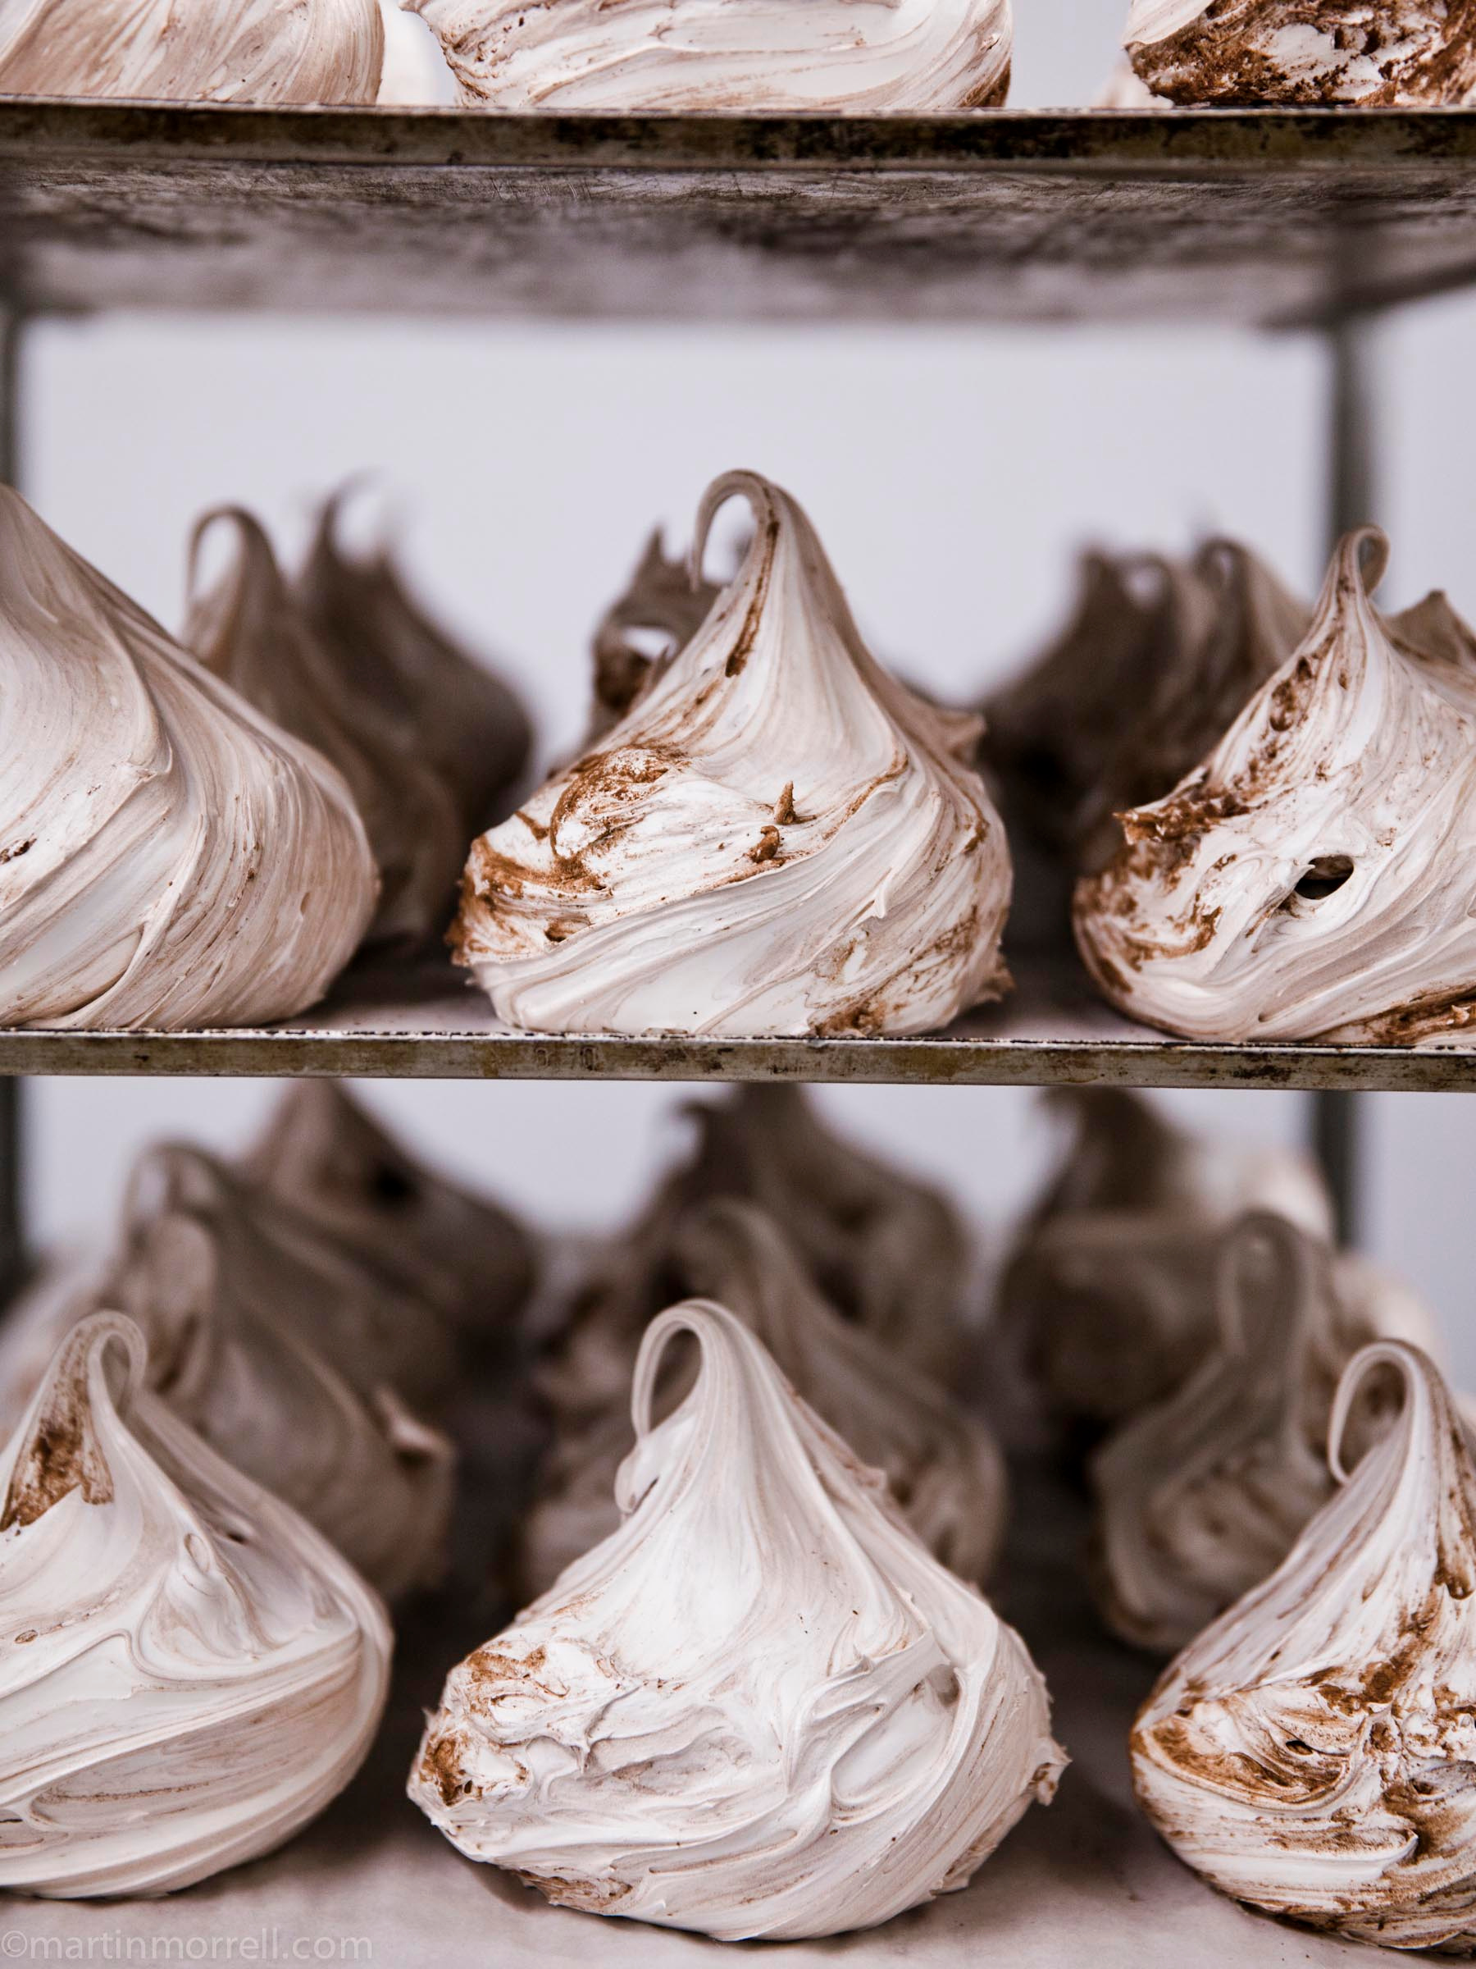
THE PATISSERIE
6
WEEKS
Run by Barry Johnson, an expert Pastry Chef, you will spend 6 weeks working in the Pastry production unit.
The Pastry team make our sweet goods that are sold in store and online, such as Cherry Bakewell, Garibaldi biscuits and our Courgette cakes. The team also create delicious seasonal products including our Christmas Yule logs and Easter cakes.
You will get hands-on experience weighing out large scale recipes, icing cakes and helping the team with general food preparation.
You will become comfortable with basic patisserie and become a pastry expert!

Slide 9
6
WEEKS
THE BAKERY
Work with our Head Baker, Michael Engler and learn to make artisan sourdough.
Our bakery produces a wide variety of artisan breads, from our wonderful seven seed loaf, to focaccia and our award winning beetroot bread.
Alongside breadmaking, you will find yourself using vienoiserie dough and learning the art of croissant folding.
During your 6 weeks in this unit, live like a baker and learn the importance of proving, shaping and baking to make the perfect loaf.

Slide 10
THE CREAMERY
6
WEEKS
Peter Kindel heads our Daylesford creamery, where we make 10 different types of award-winning cheese.
Our Friesian diary heard are milked a stones-throw away from the creamery and we use their milk for a range of products including cheese, yoghurt, kefir and butter.
Over 6 weeks you will spend time learning the different production processes for each of these products.
You will get an insight into a cheesemaker's world.

Slide 11
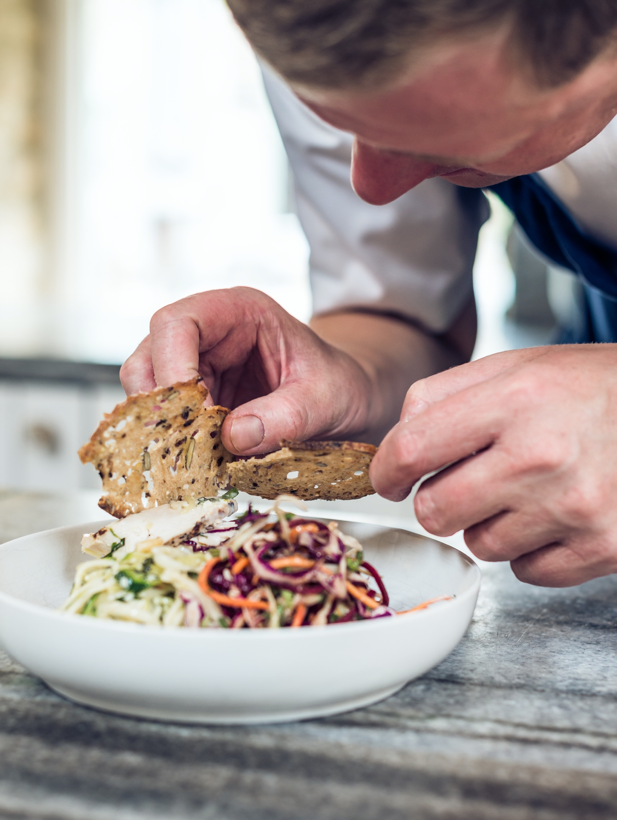
9
WEEKS
THE KITCHENS
You will spend 9 weeks in the Daylesford Kitchens, with 3 weeks in each kitchen.
OLD SPOT: This is a service kitchen which has a wood fire oven. Pizzas are hand spun and fresh seasonal pasta dishes are served to make your tastebuds tingle.
THE TROUGH: Like the Old Spot, the Trough provides gastro meals to our customers. Here you will be involved in prepping as well as on service.
EVENTS KITCHEN: The Events Kitchen could also be referred to as the heart of the kitchens. Not only is it physically situated in the middle of the farmshop, but it also provide a wealth of dishes to the deli and service kitchens.
No question is a silly question in the kitchens!

Slide 12
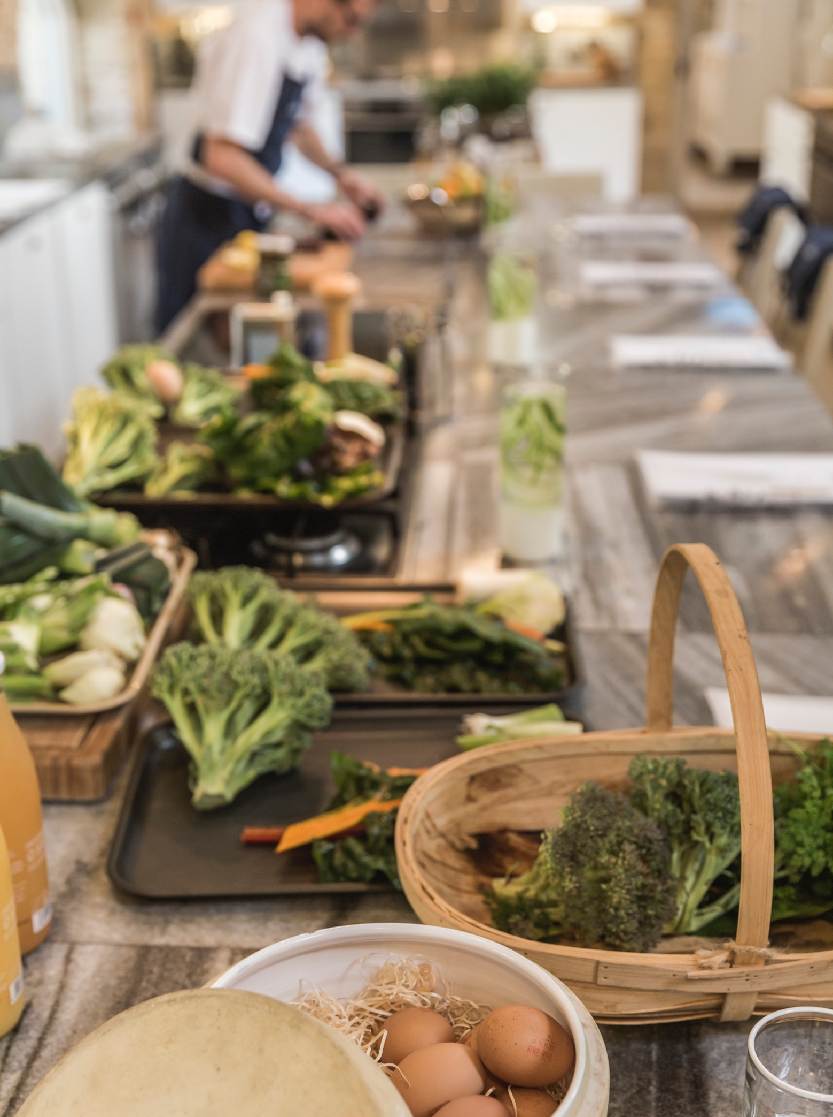
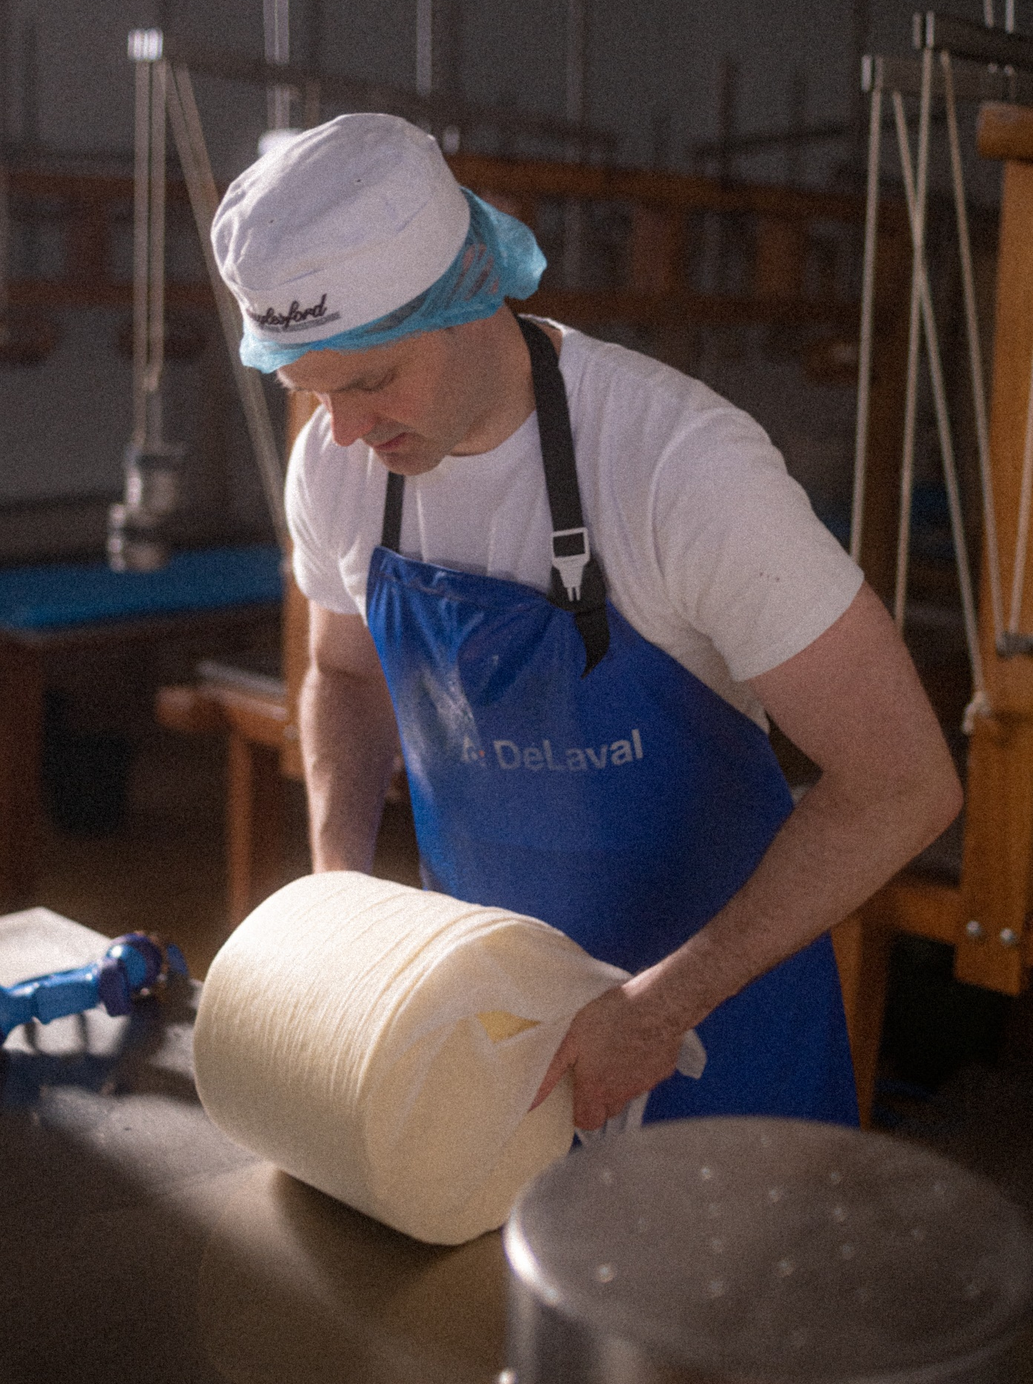
THE COOKERY SCHOOL
6
WEEKS
Our Cookery School teaches our customers how to become masters of seasonal cooking.
You will spend 6 weeks immersed in a variety of classes which range from, Seasonal dinner parties, Butchery, Pastry, Food and Nutrition, Game, Farm to Fork and Chef’s Tables. This will expose you to an advanced level of cookery knowledge that you will not ordinarily find elsewhere.
You will work alongside an experienced culinary team including head tutor James Devonshire to prepare and set up the running of the classes.

Slide 13
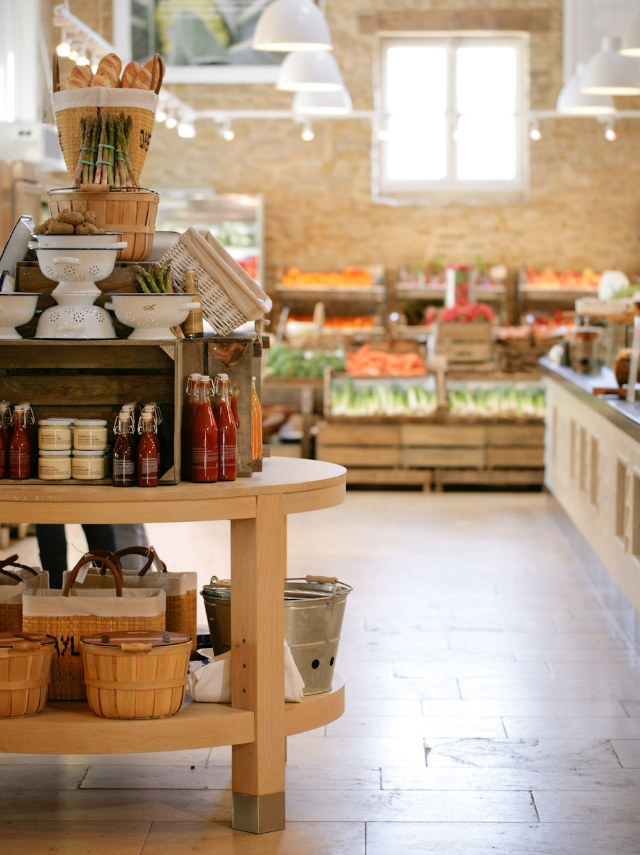
3
WEEKS
THE DELI
You will spend 3 weeks working with our Delicatessen Team in the Farm Shop.
The Deli showcases our artisan products in their glory and here you will see first-hand customers buying the products which you have made.
Working front of house provides you with the opportunity to engage with our customers and tell the story of our products.

Slide 14
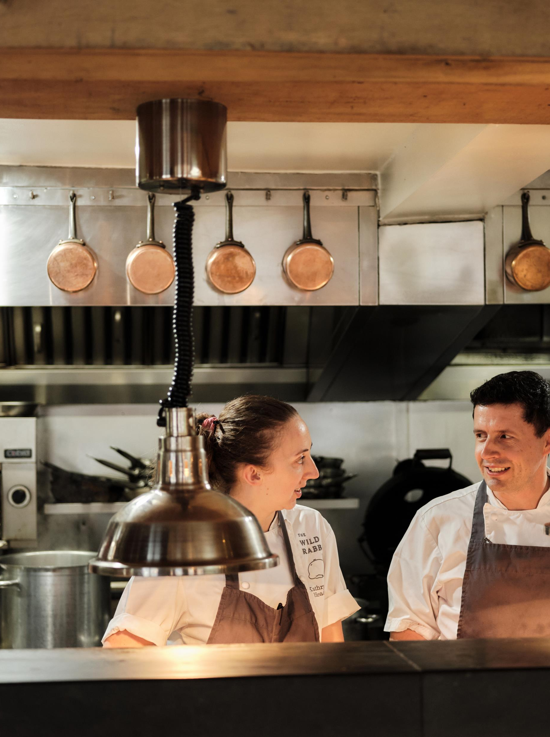
BESPOKE OPTIONS
2
WEEKS
In addition to the departments already covered, you will have 2 weeks during which you can pick to experience one of the departments below:
MARKETING
TECHNICAL
THE WILD RABBIT KITCHEN
THE FOX KITCHEN
NEW PRODUCT DEVELOPMENT
MENU DEVELOPMENT
FOOD BUYING
WHOLESALE
DESIGN/CREATIVE
RECRUITMENT
SUPPLY CHAIN/DISTRIBUTION
EVENTS
SUSTAINABILITY

Slide 15
WHAT COULD COME NEXT…
By the end of the 12-month scheme you should have a deep understanding of seasonal food that is not available elsewhere and you will leave with the knowledge of how food is produced from farm to fork.
Furthermore, the scheme gives insight into a supply chain from A to Z and how a sustainable business runs from its foundations up.
This opportunity will allow you to grow your confidence, communication and interpersonal skills, as well as your repertoire of food knowledge.

Slide 16
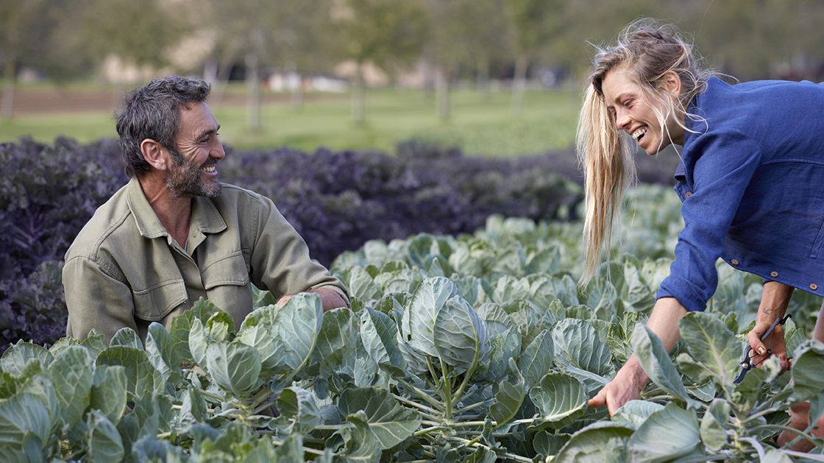
TAKE AWAY SKILLS
There are numerous exciting career opportunities here at Daylesford, whether you wish to stay in an area of the business covered by the internship programme or explore something new in the wider business.
Here is what some of our internship graduates have gone on to do:
CREAMERY ASSISTANT
COMMIS CHEF
FOOD BUYER
EVENTS ASSISTANT
GUEST SERVICES MANAGER
SOCIAL MEDIA MANAGER
COOKERY SCHOOL TUTOR
MARKET GARDENER

Slide 17
What some of our previous interns have said
My time spent as an intern was the most varied and diverse, and so much more than I expected. Once you start working at Daylesford, you realise the depth of opportunities available, and the internship is the best possible insight to this. I learnt this from my bespoke time spent with different teams and meeting people in the wider business. I am thrilled to now work within the Events team, which was a career path I had never previously considered!
Sophie, Events Assistant. Graduated Future Foodies in 2022

Slide 18
I was first drawn to Daylesford by the huge array of food it produced. The ownership of almost every step of production right from the farm to the shop floor and restaurants, with all the food predominately made by hand and largely unique, seemed incredibly exciting. After working as a chef, I thought it would be fertile ground for growing my passion.
What the future foodie internship offers that is so unique, and what is so special about Daylesford, is the possibility to experience a vast range of disciplines within food. In addition to this, the various managers and teams who work in these departments are hugely welcoming and excited to share their knowledge and passion for their respective trades. Working with people so supportive of your professional development was very inspirational. This range and depth of experience has been vital to the work I do now as a food buyer for Daylesford’s shops, kitchens, and production units. Hand picking over 100kg a week of mixed leaf salad in the freezing cold of February, really does give you a unique appreciation of the work that goes into making great food!
The future foodie internship has been foundational to my development, and has been the springboard from which the rest of my career has been built on. I’d encourage anyone who is passionate and curious about food to consider applying; it is a fantastic way to explore the food world, while also providing a groundwork of experience for future opportunities, either within Daylesford or beyond it.
Harald, Food Buyer. Graduated Future Foodies in 2017

Slide 19
Before completing the internship in October 2021, I could never have anticipated the scale of my self-development and the industry insight I would experience. Without wishing it to sound like a cliche, it was more than I ever imagined it to be. I was told to put in as much as I wanted to get out of it; I got a lot more! After finishing university, I was at a loss at how to get into the food industry. I wanted to become a chef, but I also wanted to learn about the process of food production from seed to plate and this offered it all.
This internship would not be the same without all the teams who provided support, teaching, and plenty of laughter. Building those relationships has proven invaluable, helping me immensely during my full-time job as a chef at Daylesford.
Daniella, Commis Chef. Graduated Future Foodies 2022

Slide 20
THE FINE PRINT
1 year internship programme employed on a full-time fixed term contract and starting Monday 9th September 2024
Salary of £23,800 p/a and benefits
Quarterly Socials organised by the company
Subsidised accommodation can be provided if required
20 Days holidays, plus all bank holidays off
6 month and 10 month career check in with the recruitment team
Reporting to a dedicated intern manager and buddied with a former intern now employed within the business
Internship graduation party, and certificate at the end of the year
Opportunities to understand more about permanent opportunities within the business and apply for these in the final months of the programme

Slide 21
How to apply and key dates
Applications open on 12/02/2024 and close 07/04/24
Link to Application Portal to come- here you will be asked to tell us some more about yourself, why you believe you could be a Future Foodie and how your passion in food was ignited and grown
We will let you know by 07/04/2024 if you application has progressed
At this stage you will be invited in for one of two interview events here at Daylesford where you’ll have discussions with members of the team and get a chance to meet current interns.
We will let you know by 22/05/2024 if your application has gone through to our final stage
We will invite back to Daylesford to give you some hands-on experience in our kitchen or production units.
All applicants will have the outcome of their assessment communicated to them no later than 10/06/24
All offers of places on the internship will be extended in writing by 10/06/24 with responses requested by 17/06/24
Interns will be required to be onsite to start their programme at 9am on Monday 9th September 2024

Slide 22
WWW.DAYLESFORD.COM

